Slide 1
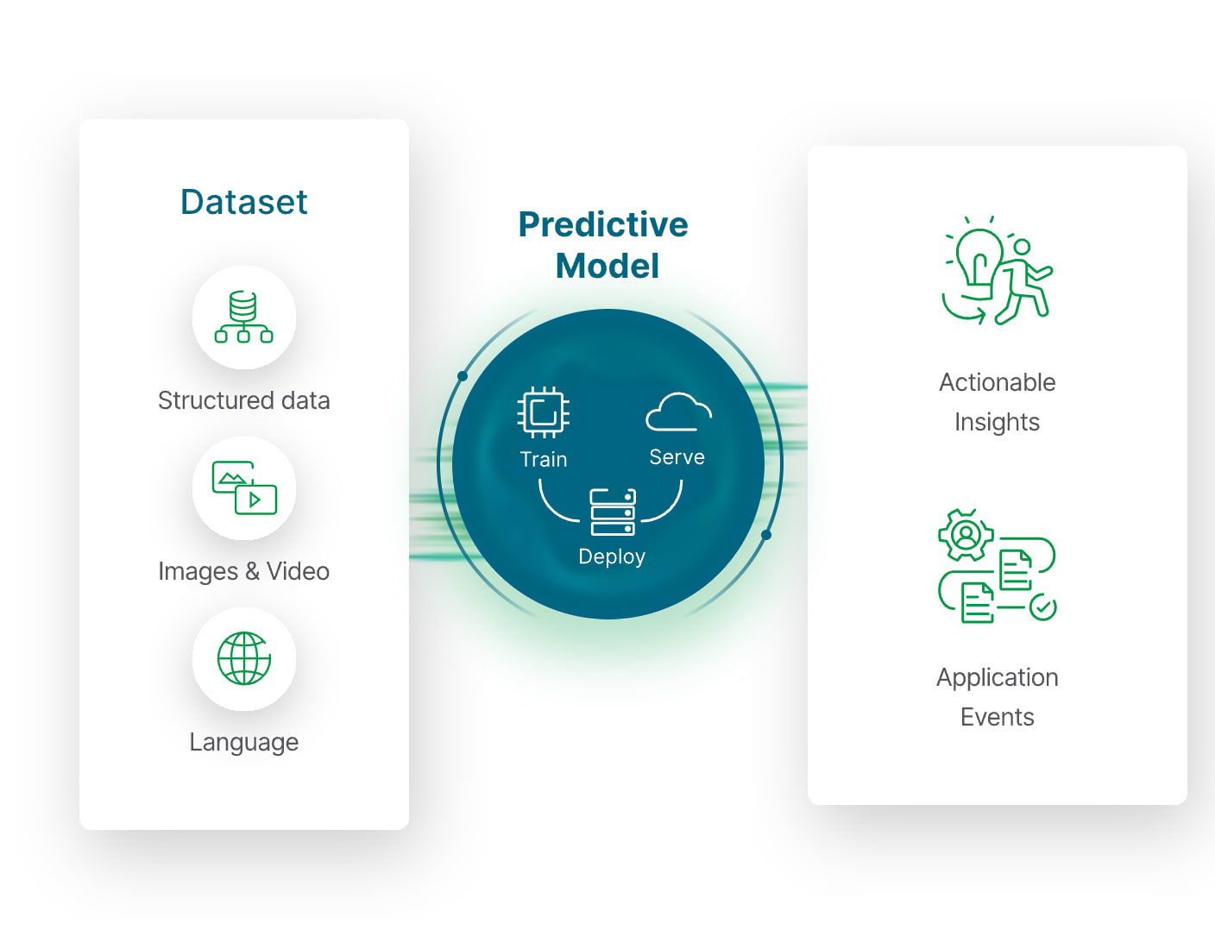


Employee Attrition Prediction Using Machine Learning
Submitted By: Abdillahi Mahdi Ibrahim
Galgotias University
Academic Year: 2025–2026

Slide 2








Introduction
What is Employee Attrition?
Employees leaving an organization voluntarily or involuntarily.
Increased Costs
Reduced Productivity
Recruitment & Training
Lower team output
Purpose
Loss of Experience
ML Solution
Identify employees likely to leave using Machine Learning.
Predict turnover early
Knowledge drain

Slide 3








Problem Statement
Proposed Solution
Increased Hiring Expenses
Develop a Machine Learning Model to predict employee attrition.
Loss of Skilled Employees
Reduced Team Performance
Identify Risk Early
Take Proactive Action
Business Disruption
Data-Driven HR

Slide 4






Project Objectives
Analyze Data
Identify Factors
Examine employee data patterns and trends
Discover key drivers affecting attrition
Build Models
Improve Retention
Develop predictive machine learning models
Enhance employee retention strategies
Support HR Decision-Making
Provide data-driven insights for proactive HR interventions

Slide 5













Dataset Information
Employee Attrition Prediction Dataset
Source: Kaggle
Features Include:
Age
Gender
Department
Job Role
Target Variable
Monthly Income
Years at Company
Job Satisfaction
Attrition Status
No
Employee Stays
Yes
Employee Leaves

Slide 6













Technology Stack
Libraries
Dev Tools
Pandas
Jupyter Notebook
Programming
NumPy
VS Code
Matplotlib
Python
GitHub
Core Language
Seaborn
Scikit-Learn

Slide 7









Project Workflow
Data Collection
Feature Engineering
Gather employee datasets
Select and create relevant features
Data Cleaning
Model Training
Remove missing values and duplicates
Train Random Forest Classifier
Data Preprocessing
Model Evaluation
Encode and split data
Assess accuracy and metrics
Exploratory Data Analysis
Prediction
Visualize patterns and insights
Forecast employee attrition

Slide 8








Data Preprocessing
Feature Encoding
Data Cleaning
Data Splitting
Remove missing values
Convert categorical data to numerical
Training Data
80%
Handle duplicates
Label encoding for ordinal data
Outlier treatment
One-hot encoding for nominal data
Testing Data
20%

Slide 9


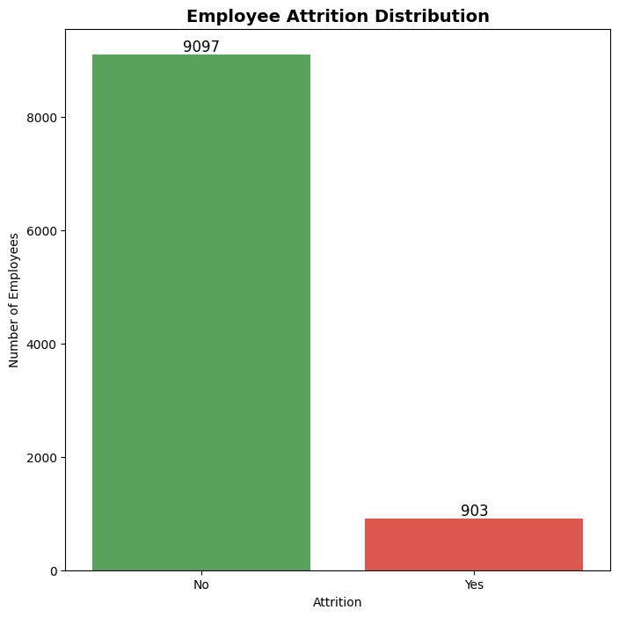






Exploratory Data Analysis
Data Analysis Graphs
Visualizations
Attrition Distribution
Department-wise Attrition
Salary Distribution
Job Satisfaction Analysis
Benefits
Understand employee behavior
Identify important patterns
Discover key risk factors

Slide 10
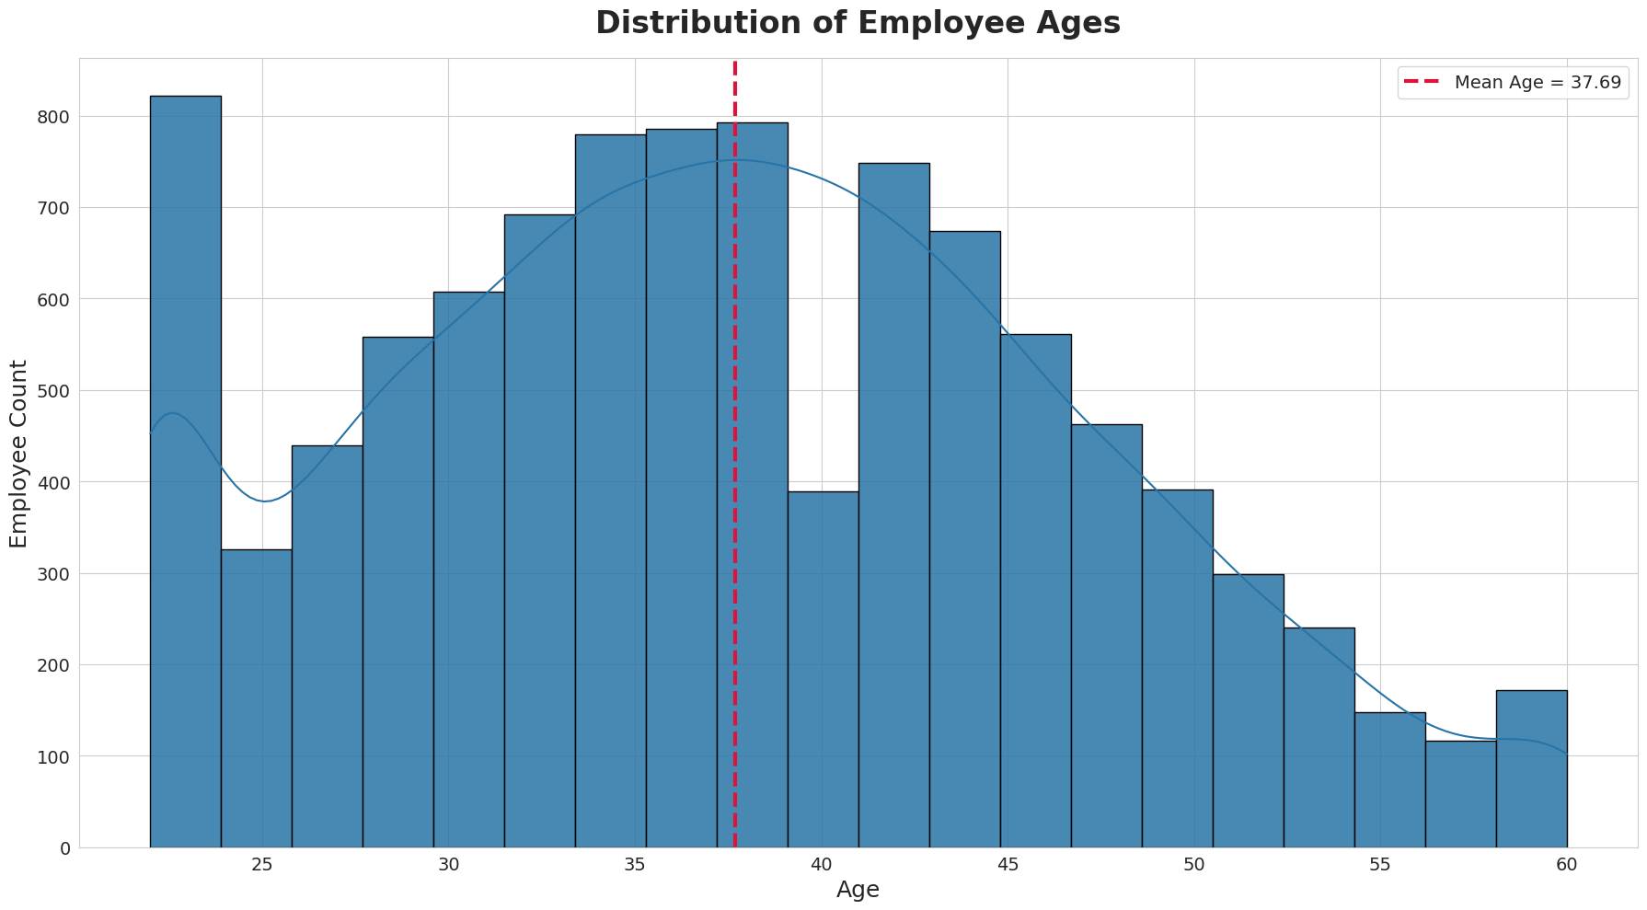
Exploratory Data Analysis

Slide 11
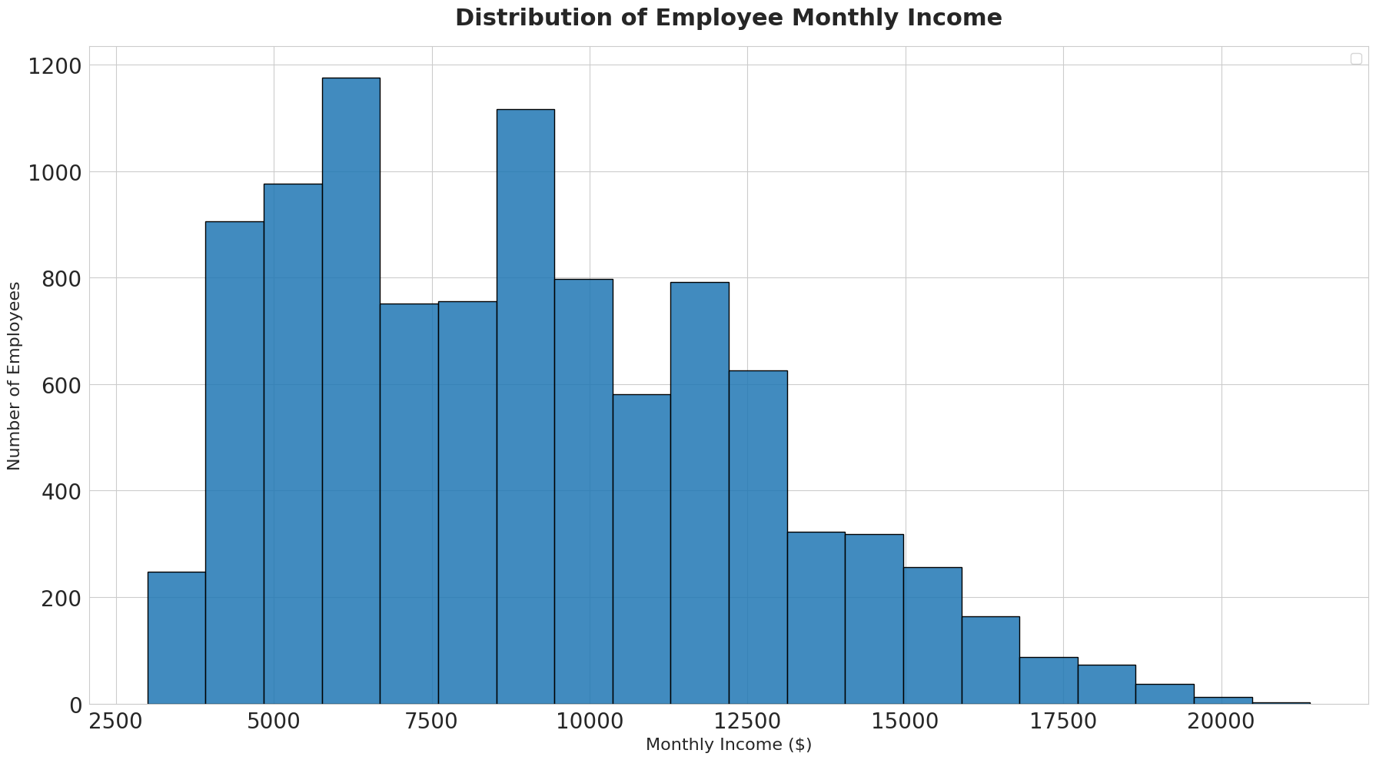
Exploratory Data Analysis

Slide 12
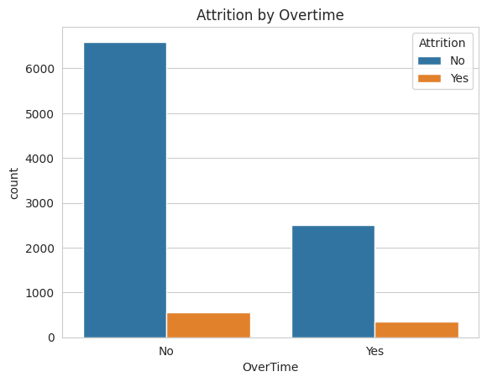
Exploratory Data Analysis

Slide 13
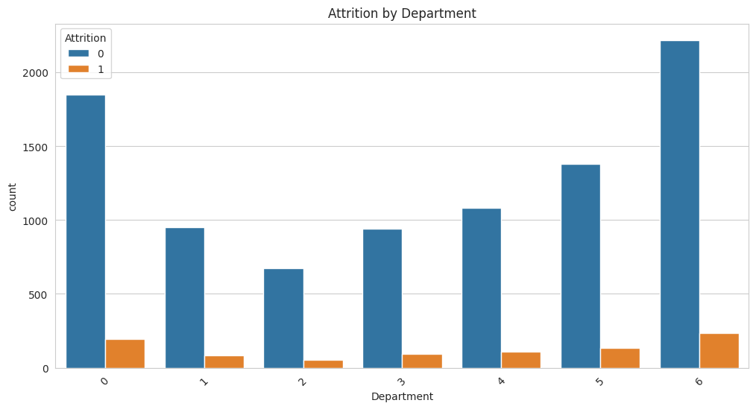
Exploratory Data Analysis

Slide 14
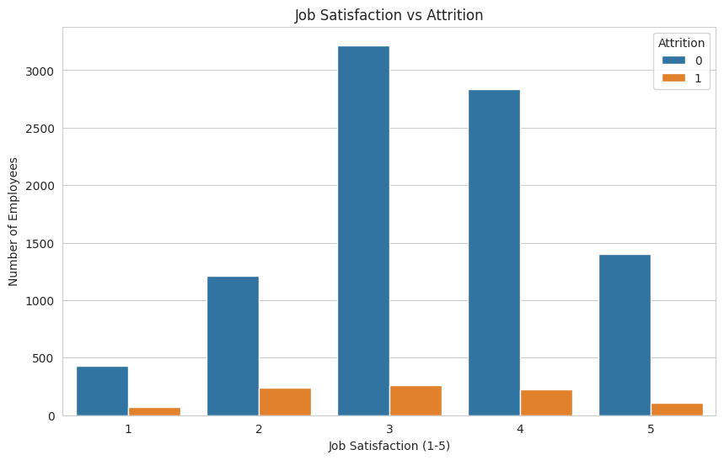
Exploratory Data Analysis

Slide 15
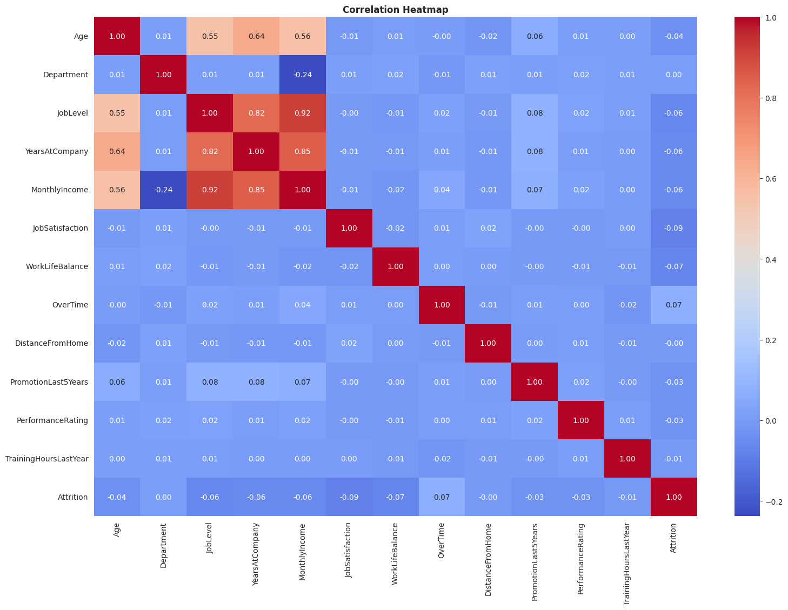
Exploratory Data Analysis

Slide 16





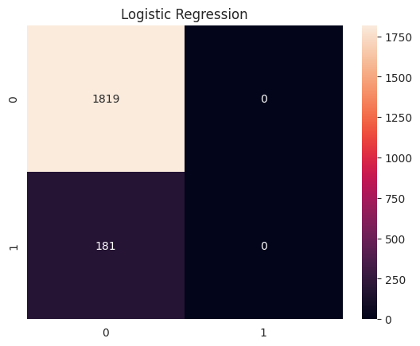







Machine Learning Model
Logistic Regression
Why Logistic Regression
Classifier Algorithm
High Accuracy
Scalability
Logistic Regression is well-suited for predicting whether an employee will stay or leave the organization.
Robust predictions
Handles large datasets
Reduces Overfitting
Feature Importance
Ensemble approach
simple, fast, and easy to interpret
Training Process
Train Model
Learn Patterns
Predict Attrition

Slide 17

Machine Learning Model
Random Forest
Classifier Algorithm
Why Random Forest?
An ensemble learning method that constructs multiple decision trees during training and outputs the mode of the classes for classification.
High Accuracy
Scalability
Robust predictions
Handles large datasets
Reduces Overfitting
Feature Importance
Ensemble approach
Easy interpretation
Training Process
Train Model
Learn Patterns
Predict Attrition

Slide 18












Model Evaluation
Performance Metrics
Model Results
Accuracy
Precision
Overall correctness
True positive rate
Accuracy
Precision
Recall
F1 Score
85%
83%
Sensitivity measure
Balanced metric
Recall
F1 Score
Confusion Matrix
81%
82%
Visualizes True Positives, True Negatives, False Positives, and False Negatives

Slide 19
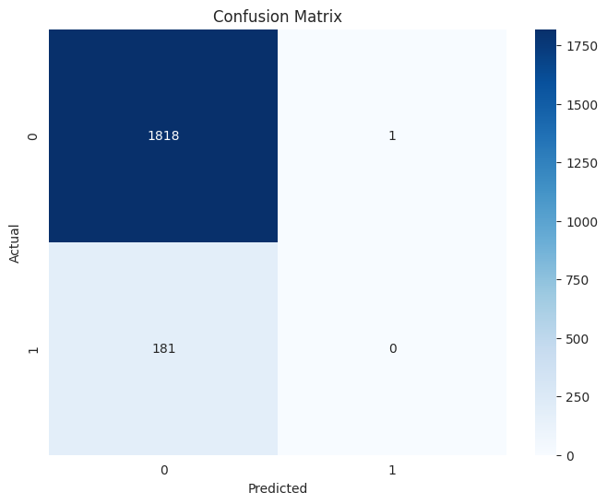
Model Evaluation

Slide 20












Prediction System
Input
Feature
Output
Age
Feature
Employee Likely to Stay
Department
Retention strategies may not be urgent
Feature
Salary
ML Model
Prediction Engine
Employee Likely to Leave
Feature
Experience
Intervention required immediately
Feature
Satisfaction Level

Slide 21






Advantages
Reduces Turnover
Supports HR Decisions
Saves Recruitment Costs
Identifies at-risk employees early for proactive retention
Provides data-driven insights for strategic planning
Minimizes expenses associated with hiring and training
Improves Workforce Planning
Increases Retention
Enables better resource allocation and succession planning
Helps create a more stable and experienced workforce

Slide 22







Conclusion
Retain Talent
Employee attrition prediction helps organizations retain talent
Identify At-Risk Employees
Machine learning can identify employees at risk of leaving
Thank You
HR Insights
The developed system provides valuable insights for HR departments
Questions?
Ready to answer your queries
Data-Driven Decisions
The project supports data-driven decision making

Slide 23






Future Scope
Web-based Application
Real-time Monitoring
Deep Learning Models
Deploy as a user-friendly web interface for HR professionals
Implement live tracking of employee satisfaction metrics
Explore neural networks for enhanced prediction accuracy
HR Dashboard
Automated Risk Alerts
Cloud Deployment
Create interactive visualization for workforce analytics
Send notifications when high-risk employees are identified
Scale the solution on cloud infrastructure for enterprise use

